Slide 1
CSS 422 Hardware and Computer Organization
ARM Memory Access Instructions
Ver. 3
Professor: Munehiro Fukuda

Slide 2
Topics
Addressing modes
Immediate offset addressing
Register offset addressing
Linked list example
PC-relative addressing
LDR Rn, =label, ADR RN, label
Literal pool
Load/Store multiple words
Push and Pop
Function call example

Slide 3
Accessing Memory
CISC (e.g., MC68000)
RISC (e.g., ARM)
Most CPU instructions can transfer data from and to memory.
Only memory-access instructions are allowed to carry out data transfer
LDR, STR, LDM, STM, ADR, POP, and PUSH only
Addressing modes | Example
Immediate addressing | ADDI.W #$FF, D0 ; D0 += 0xFF;
Address register indirect with pre-decrement with post-increment | SUB.B -(A0), D0 ; D0 -= *(--A0); ADD.B (A0)+, D0 ; D0 += *A0++;
Absolute addressing Half ward Word | MOVEA.W #$7FFF, A1 MOVEA.L #$8000, A1 LEA
Addressing mode | Example
Immediate offset addressing Pre-indexed offset addressing Pre-indexed offset with wirteback post-indexed offset addressing | LDR R0, [R1] LDR R8, [R10, #4]! LDR R0, [R6], #4
Register offset addressing Pre-indexed offset addressing Pre-indexed offset with wirteback post-indexed offset addressing | LDR R3, [R2, R0, LSL #1] LDR R3, [R2, R0, LSL #1]! LDR R3, [R2], R0, LSL #1
PC-relative addressing LDR Rn, label ADR Rn, label | LDR R1, =var1 ADR R8, data6; the addr of data6

Slide 4
Immediate Offset Addressing
Addressing mode | Instructions | Data to access | Base address register | Examples
Pre-index | LDR {type}{cond} Rt, [Rn, #offset] | read from mem[Rn + offset] | not updated | LDR R0, [R1] ; R0←mem[R1]
 | STR {type}{cond} Rt, [Rn, #offset] | write to mem[Rn + offset] | not updated | STR R2, [R9, #0x7] ; mem[R9+0x7]←R2
Pre-index with writeback | LDR {type}{cond} Rt, [Rn, #offset]! | read from mem[Rn + offset] | Rn + offset | LDR R8, [R10, #4]! ; R10←R10+4, R8←mem[R10]
 | STR {type}{cond} Rt, [Rn, #offset]! | write to mem[Rn + offset] | Rn + offset | STR R2, [R9, #0xA]! ; R9←R9 + 0xA, mem[R9]←R2
Post-index | LDR {type}{cond} Rt, [Rn], #offset | read from mem[Rn] | Rn + offset | LDR R0, [R6], #4 ; R0 ←mem[R6], R6 ←R6+4
 | STR {type}{cond} Rt, [Rn], #offset | write to mem[Rn] | Rn + offset | STR R1, [R3], #5 ; mem[R3]←R1, R3←R3+5
offset:
-255 .. +255 in 16-bit instructions
-4095 .. + 4095 in 32-bit instructions

Slide 5
RTL Example (LDR)
3. pre-index with writeback
LDR R0, [R1]
MAR ← PC, PC ← PC + 2
IR ← mem[MAR]
MAR ← R1
R0 ← mem[MAR]
STR R0, [R1, #4]!
MAR ← PC, PC ← PC + 2
IR ← mem[MAR]
R1 ← R1 + 4
MAR ← R1
R0 → mem[MAR]
1.2. Instr. fetching

Slide 6
An Example of Pre-Indexed Offset Addressing
; An assembly program that reverses a string
Stack EQU 0x400
AREA STACK , NOINIT , READWRITE , ALIGN =3
MyStackMem SPACE Stack
AREA RESET , READONLY
EXPORT __Vectors
__Vectors
DCD MyStackMem + Stack ; stack pointer for empty stack
DCD Reset_Handler ; reset vector
AREA MyData, DATA, READWRITE
dst SPACE 0x10
AREA MYCODE, CODE, READONLY
src DCB "HELLO WORLD", 0
ALIGN
ENTRY
EXPORT Reset_Handler
Reset_Handler
LDR R0, =src
LDR R2, =dst
LDRB R1, [R0]
loop
CMP R1, #0 ; First enumerate the number of
BEQ copy ; elements in the source array
ADD R4, #1
LDRB R1, [R0, #1]!
B loop
copy
CMP R4, #0
BEQ End_Prog
copy1
LDRB R1, [R0, #-1]! ; Start with the last element of
STRB R1, [R2] ; source array and store element
ADD R2, #1 ; by element
SUBS R4, #1
BNE copy1
End_Prog B End_Prog
END
Address | Contents | Remark
0x0000.0000 | 0x0410 | Stack pointer
0x0000.0002 | 0x2000
0x0000.0004 | 0x0015 | Reset_hander
0x0000.0006 | 0x0000
0x0000.0008 | 0x4548 | “EH”
0x0000.000A | 0x4C4C | “LL”
0x0000.000C | 0x204F | “ O”
0x0000.000E | 0x4F57 | “OW”
0x0000.0010 | 0x4C52 | “LR”
0x0000.0012 | 0x0044 | “0D”
0x0000.0014 | LDR R0, =src | src = 0x003C
0x0000.0016 | LDR R2, =dst | dst = 0x0040
...
0x0000.003A | B End_Prog | End_Prog = 0x003A
0x0000.003C | 0x0008
0x0000.003E | 0x0000 | src address
0x0000.0040 | 0x0000
0x0000.0044 | 0x2000 | dst address
...
0x2000.0000 | 0x444C | “DL”
0x2000.0002 | 0x524F | “RO”
0x2000.0004 | 0x5720 | “W “
0x2000.0006 | 0x4F4C | “OL”
0x2000.0008 | 0x4C45 | “LE”
0x2000.000A | 0X4800 | “H\0”
Vector Table
ROM
(Read-Only Data)
ROM (Code)
ROM
(Literal Pool)
SRAM (Read/Write)

Slide 7
Register Offset Addressing
Addressing mode | Instructions | Data to access | Base address register | Examples
Pre-index | LDR {type}{cond} Rt, [Rn, Rm{, LSL #n}] | read from mem[Rn + Rm * 2^{n}] | not updated | LDR R3, [R2, R0, LSL #1] ; R3←mem[R2 + R0 * 2]
 | STR {type}{cond} Rt, [Rn, Rm{, LSL #n}] | write to mem[Rn + Rm * 2^{n}] | not updated | STR R7, [R4, R2, LSL #2] ; mem[R4 + R2 * 2²]←R7
Pre-index with writeback | LDR {type}{cond} Rt, [Rn, Rm{, LSL #n}]! | read from mem[Rn + Rm * 2^{n}] | Rn + offset | LDR R3, [R2, R0, LSL #1]! ; R2←R2+R0*2, R3←mem[R2]
 | STR {type}{cond} Rt, [Rn, Rm{, LSL #n}]! | write to mem[Rn + Rm * 2^{n}] | Rn + offset | STR R7, [R4, R2, LSL #2]! ; R4←R4+R2*2², mem[R4]←R7
Post-index | LDR {type}{cond} Rt, [Rn], Rm{, LSL #n} | read from mem[Rn] | Rn + offset | LDR R3, [R2], R0, LSL #1 ; R3←mem[R2], R2←R2+R0*2
 | STR {type}{cond} Rt, [Rn], Rm{, LSL #n} | write to mem[Rn] | Rn + offset | STR R7, [R4], R2, LSL #2 ; mem[R4]←R7, R4←R4+R2*2²

Slide 8
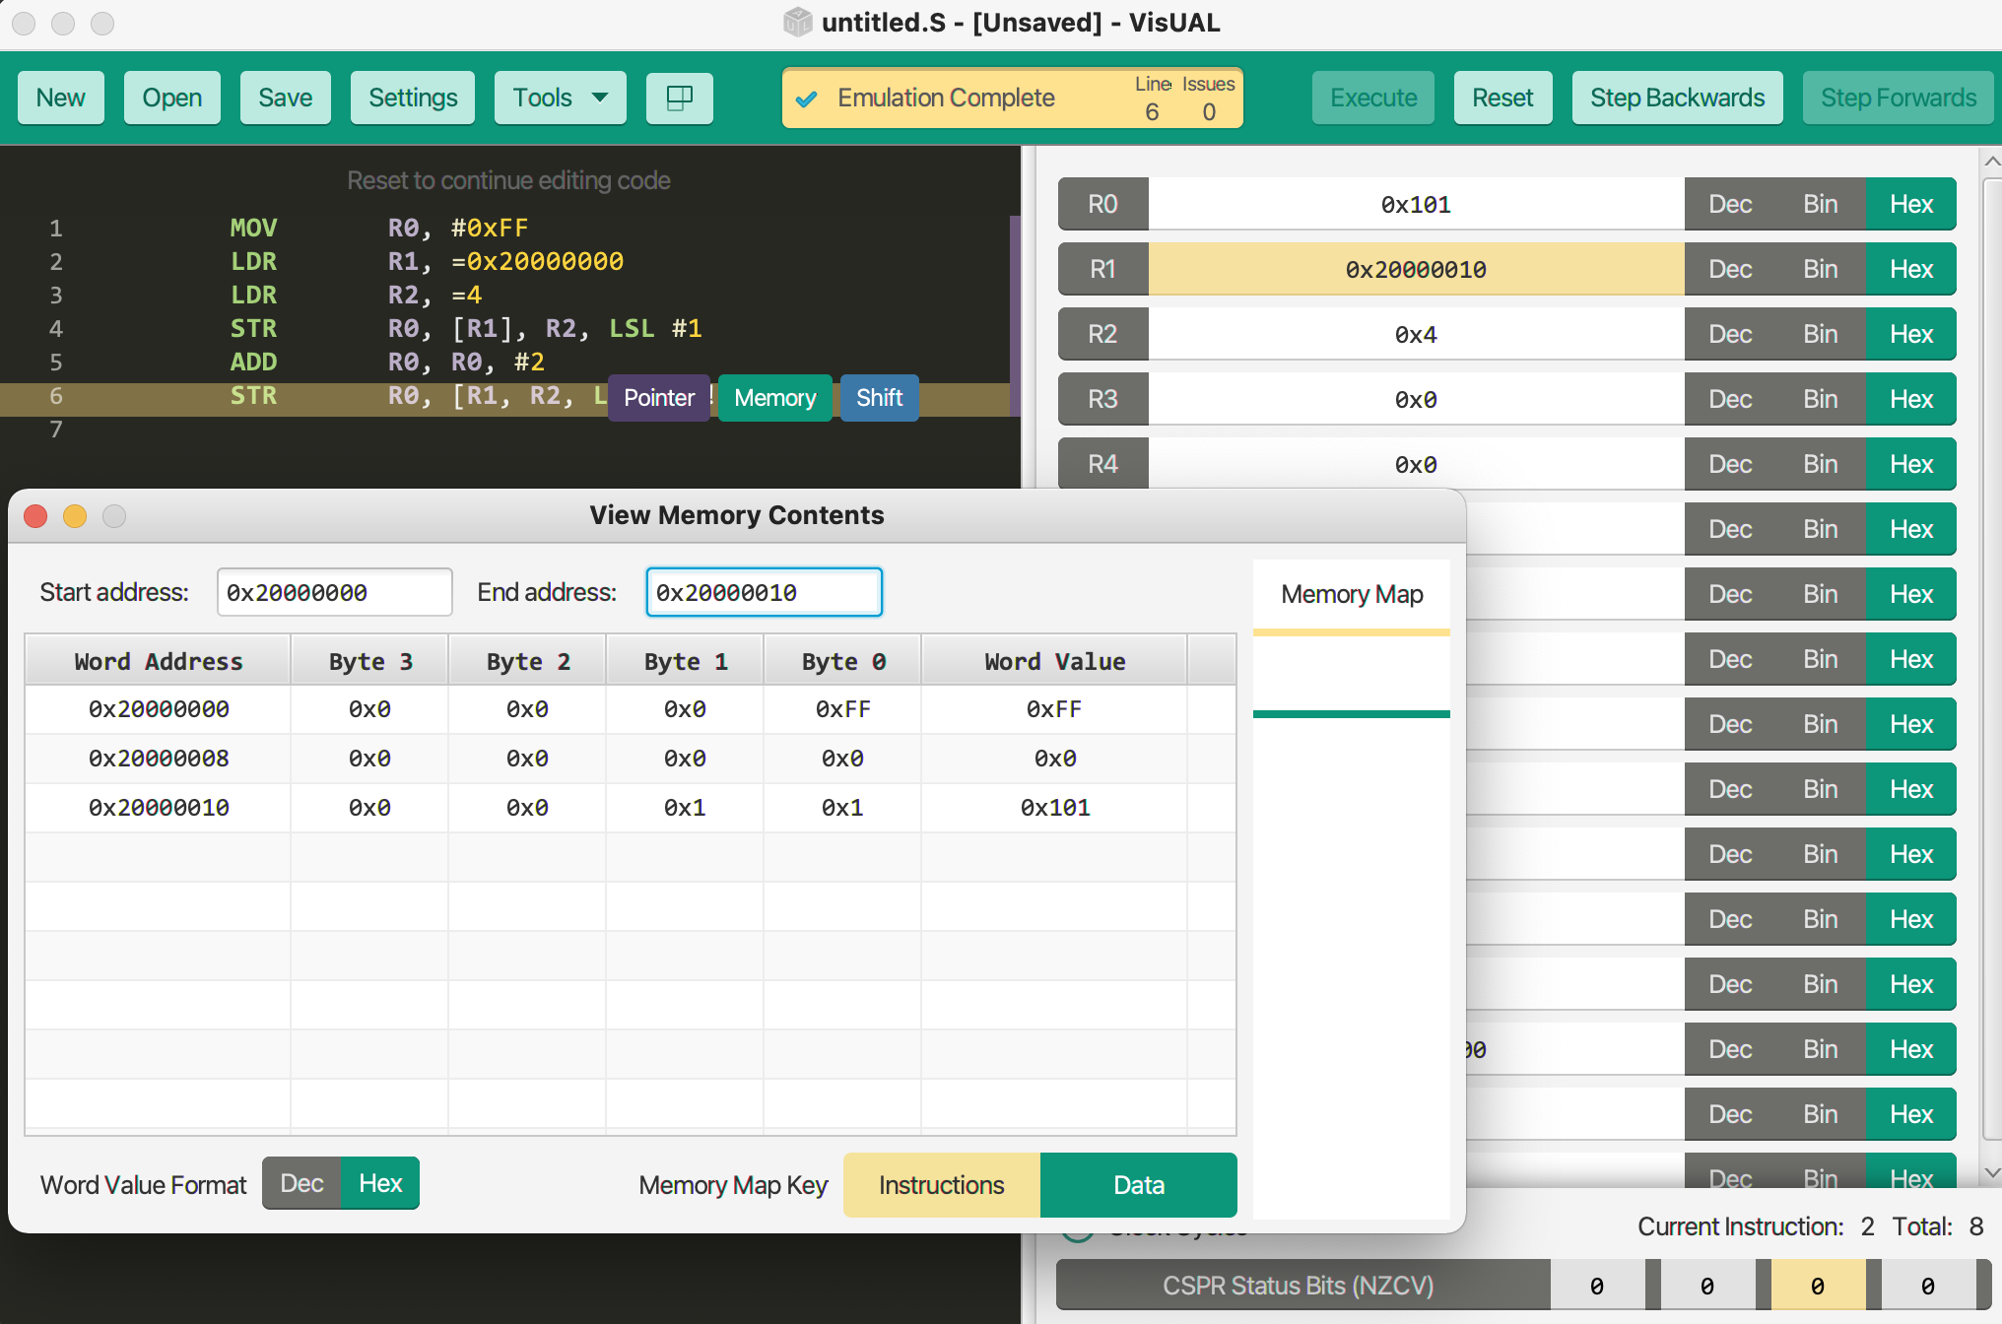
An Example of Register Offset Addressing
MOV R0, #0xFF
LDR R1, =0x20000000
LDR R2, =4
STR R0, [R1], R2, LSL #1
ADD R0, R0, #2
STR R0, [R1, R2, LSL #1]!

Slide 9
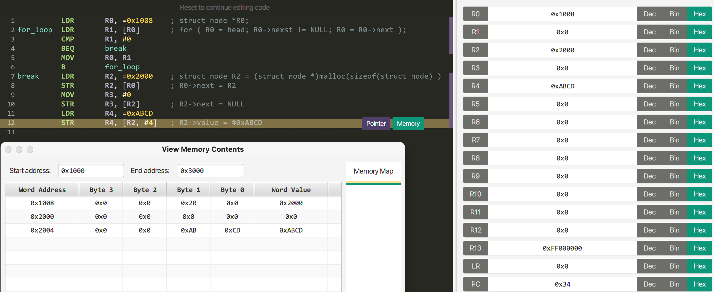
Linked List Example with Pre-Indexed/Register Offset Addressing
struct node {
struct node *next;
int value;
}
Append a new list node.
struct node *head;
0
1008
1125
1010
2345
1018
12FC
0
1234
0
ABCD
2000

Slide 10
PC-Relative Addressing Mode
Assembly Code | Actual Instructions | Examples | Descriptions
LDR{type}{cond} Rt, label | LDR{type}{cond} Rt, [PC, #offset] where offset = label - PC | LDR R0, var1 | load the 1st element of var1 into R0
LDR{type}{cond} Rt, =label | ADD{cond} Rt, PC, #offset where offset = label - PC | LDR R1, =var1 | load the address of var1 into R1
Note that offset must be +/-4095, which in turn means that label is the address within +/-4095 from the current address that PC contains.
LDR R1, var1
violates var1 <= PC + 4095.
Instead
LDR R1, =var1
LDR R0, [R1]
var1: 0x00000200
LDR R1, =var1
#offset = 0x200 – 0x104 = 0xFC = 252
PC: 0x00000104

Slide 11
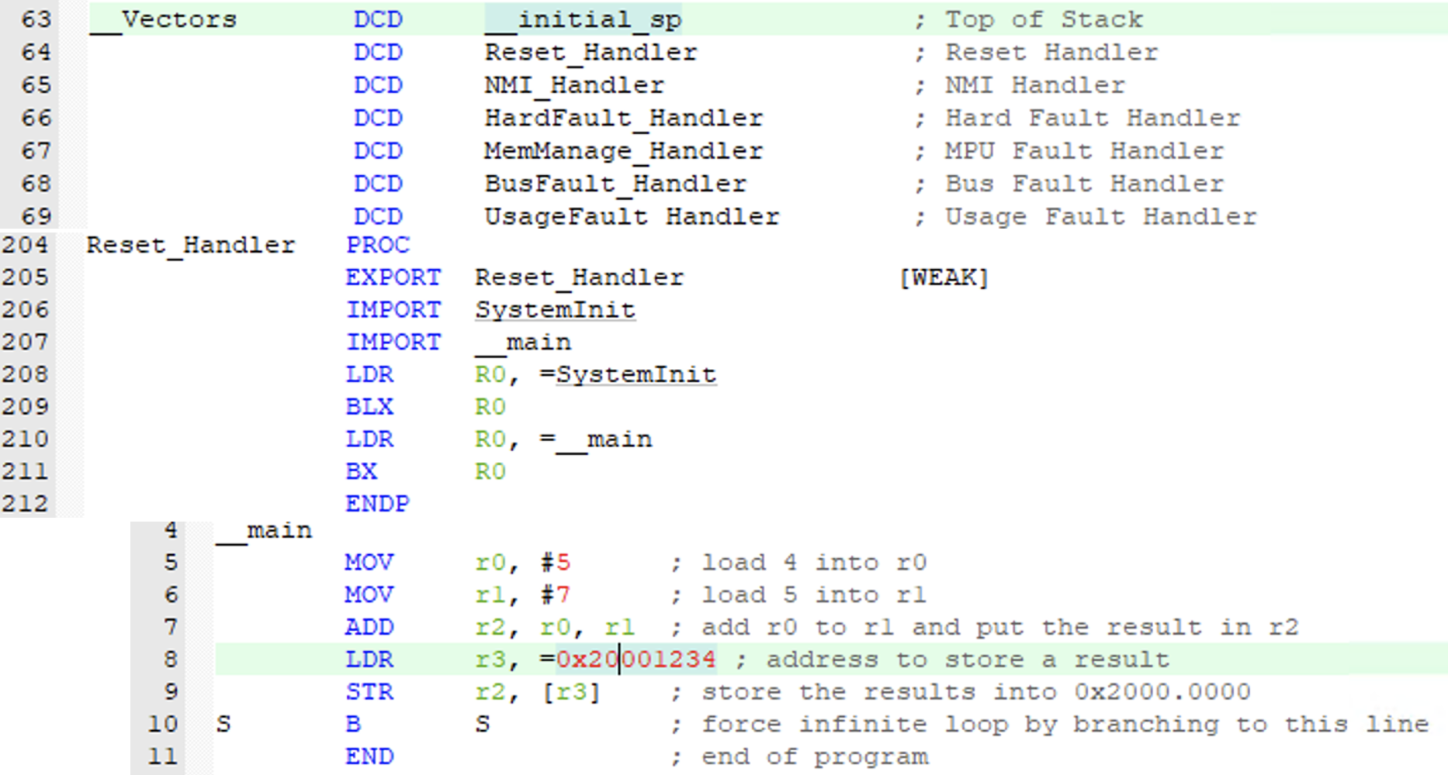
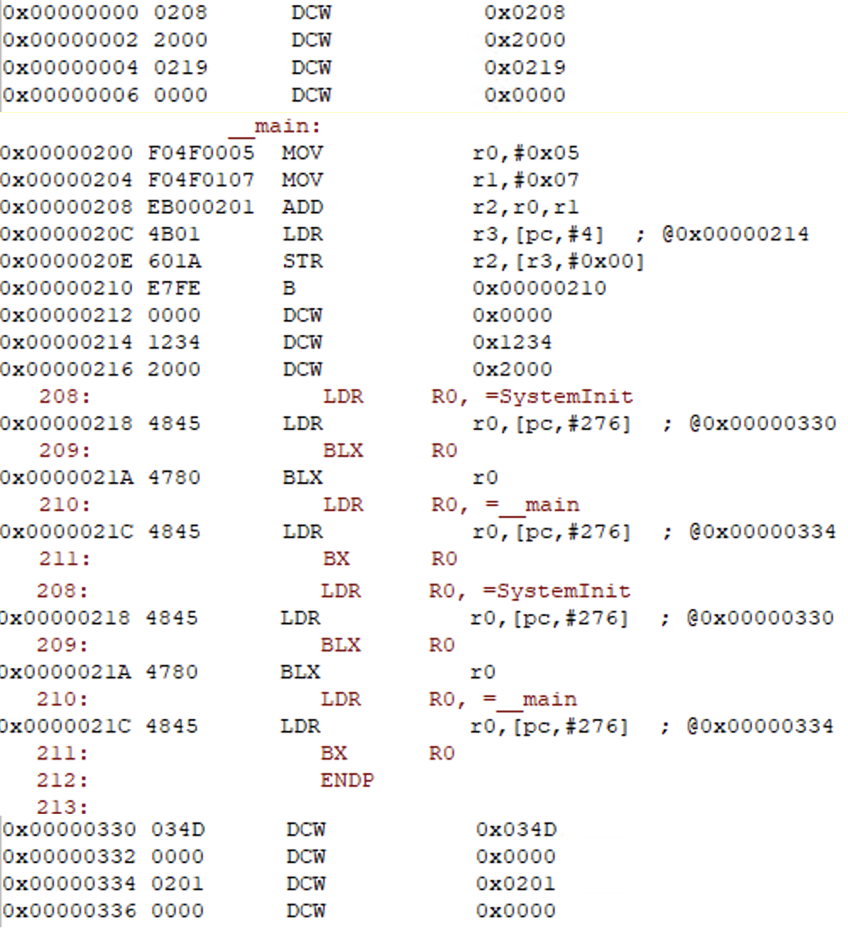
PC-Relative Addressing Example
Assembly code
Machine code
Vector table
Reset_Handler
Main program

Slide 12
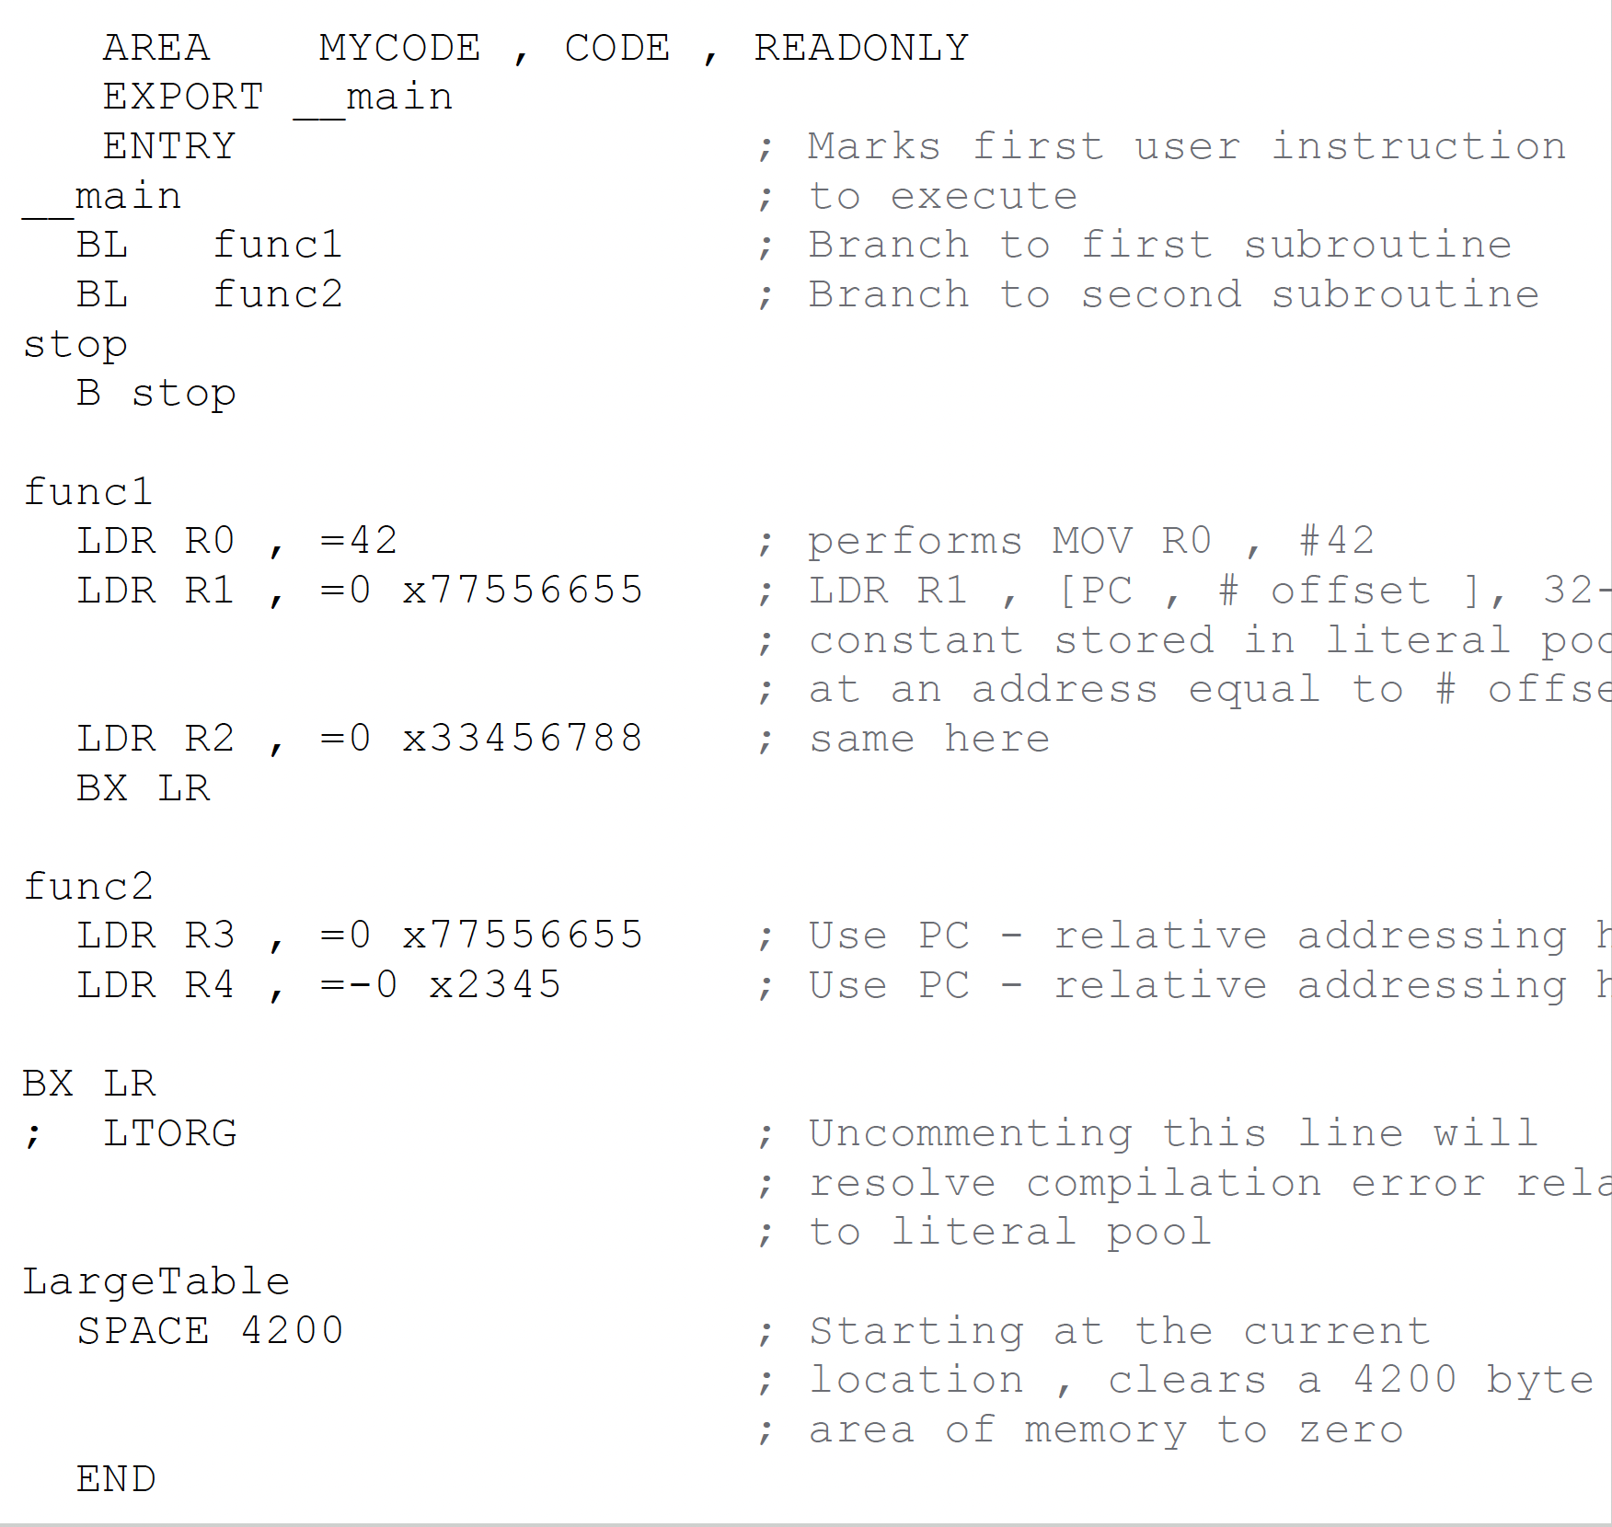
Literal Pool
Problem
Your main program may have long code so that PC-relative addressing can’t allocate a space to maintain some literals within +/-4095 bytes from the current PC.
__main
xxx
yyy
LDR R1, =0x77556655
...
...
stop B stop
Solution
> 4096
Assembler can’t allocate a space for 0x77556655 here.
Manually insert LTORG (literal pool) within 4096 bytes from PC right after B or BX, (i.e. no code after these won’t be executed)

Slide 13
LDR and ADR Instructions
The same operation: loading 0x2233 into R8
LDR R8, =data6
data6 DCD 0x2233
ADR R8, data6
; @address 0x2233
data6 SPACE 4
Difference includes:
Need 8 bytes
4 bytes: encoding the LDR
4 bytes: 0x00002233
data6 may be 0x200F4000
Need 4 bytes only
encoding the ADR with data6
data6 (0x2233) must be in 4095 from PC

Slide 14
LDM/STM
Assembly Code | Descriptions | Examples | Descriptions
STMDB{cond} Rd{!}, registers | Store multiple words into the memory address specified by Rd. The memory address decremented before each access Order: R15 → R0 With !, Rd is decremented accordingly. Otherwise, Rd unchanged STMDB SP!, registers = PUSH registers | STMDB R0!, {r1-r3} | R0 = 0x2000000C mem[0x2000008] ← R3 mem[0x2000004] ← R2 mem[0x2000000] ← R1 R0 = 0x20000000
LDMIA{cond} Rd{!}, registers | Load multiple words from the memory address specified by Rd into registers. The memory address incremented after each access Order: R0 → R15 With !, Rd is incremented accordingly. Otherwise, Rd unchanged LDMIA SP!, register = POP registers | LDMIA r0!, {r1-r3} | r0 = 0x20000000 R1 ← mem[0x20000000] R2 ← mem[0x20000004] R3 ← mem[0x20000008] r0 ← 0x2000000C
STMIA{cond} Rd{!}, registers | Store multiple words into the memory address specified by Rd. The memory address incremented after each access Order: R0 → R15 With !, Rd is decremented accordingly. Otherwise, Rd unchanged | STMIA R8!, {r0-r3} | R0 = 0x20000000 mem[0x2000000] ← R1 mem[0x2000004] ← R2 mem[0x2000008] ← R3 R0 = 0x2000000C
LDMDB{cond} Rd{!}, registers | Load multiple words from the memory address specified by Rd into registers. The memory address decremented before each access Order: R15 → R0 With !, Rd is incremented accordingly. Otherwise, Rd unchanged | LDMDB r0!, {r-r3} | r0 = 0x2000000C R3 ← mem[0x20000008] R2 ← mem[0x20000004] R1 ← mem[0x20000000] r0 ← 0x20000000
DB (decrement before each access): R15 → R0
IA (increment after each access): R0 → R15

Slide 15
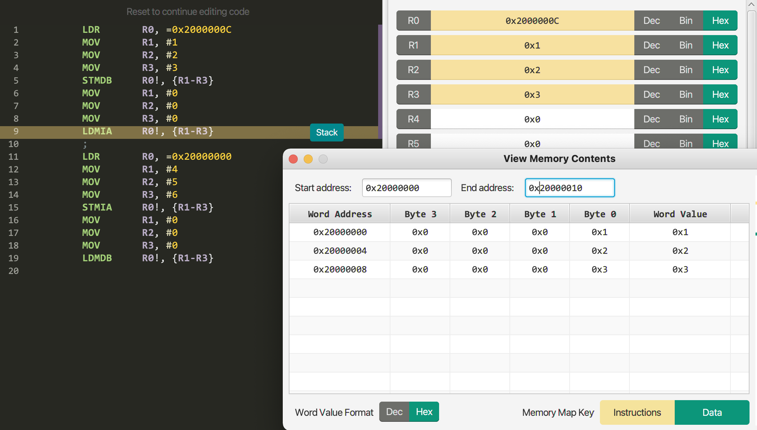
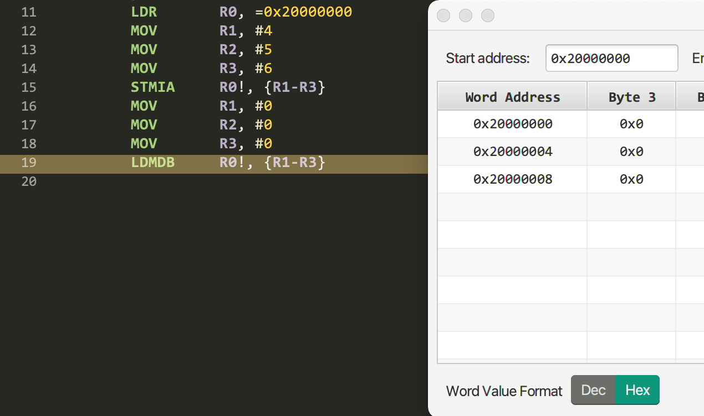
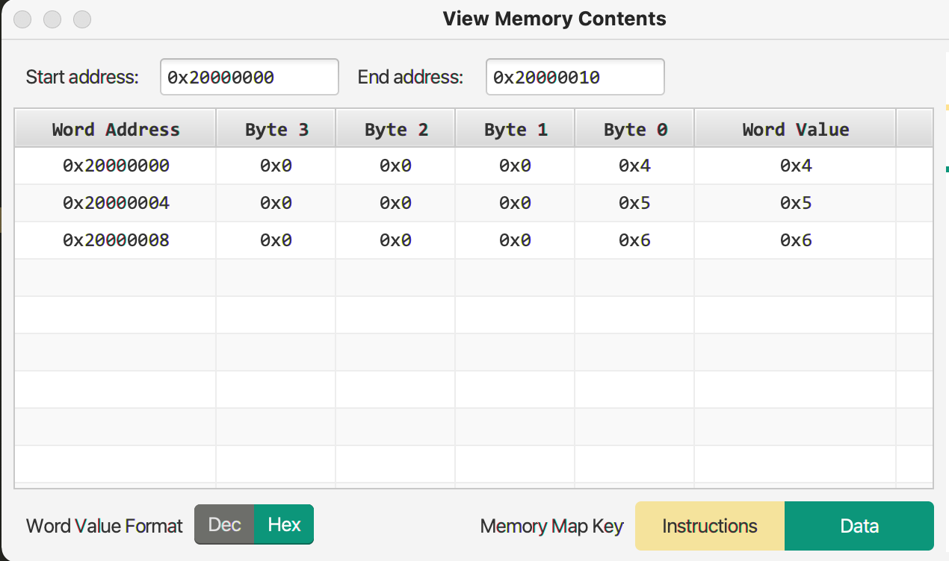
LDM/STM Example
STMDB
LDMIA
STMIA
LDMDB

Slide 16
PUSH and POP
PUSH{cond} registers
POP{cond} registers
STMDB SP!, registers
LDMIA SP!, register
R0
R1
R2
R3
A
B
B
A
SP
0x200000F8
0x200000F8
0x200000F8
B
0x200000F8
0x200000F8
0x200000FC
0x200000FC
A
0x200000FC
A
0x200000FC
A
0x200000FC
0x20000100
0x20000100
0x20000100
0x20000100
0x20000100
Initial state
PUSH R0
PUSH R1
POP R2
POP R3

Slide 17
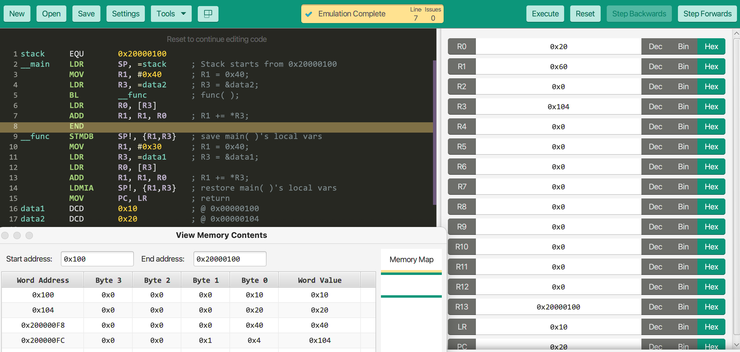
A Subroutine Call
int data1 = 0x10;
int data2 = 0x20;
void func( ) {
register short D1 = 0x30;
register short* A3 = &data1;
D1 += *A3;
}
void main( ) {
register short D1 = 0x40;
register short* A3 = &data2;
func( );
D1 += *A3;
}
for subroutine( )
-(R13)
0x200000F8
D1: $40
0x200000FC
A3: 0x104 (data2)
Activation record or
stack frame for main( )
sp (R13)
0x20000100
(R13)+

Slide 18
Stack Rule
The push and pop operations should always be performed inside the memory region specified for stack.
The number of push operations should always have a matching number of pop operations following a specified order.
If violated,
stack overflow or stack underflow occurs.

Slide 19
Summary
What is the main difference between CISC and RISC in accessing memory?
What applications can use pre-indexed/register-indexed address?
Why do we want to use LDR Rn, =#value besides MOV Rn, #value?
What is the difference between LDR Rn, =label and ADR Rn, label?
Why do we need LTORG?
Why do we need PUSH and POP?
How can PUSH be replaced with STM?
How can POP be replaced with LDM?

